Slide 1
Purdue excellence in research administration: PERA
April 2024 Update

Slide 2
PERA: Purdue Excellence in Research Administration
Information Session Logistics
Please remain muted throughout the session
Log your questions in the chat
This is one of four sessions
Each session will be recorded
Content for each session is the same
Recording and consolidated Q&A will be posted to PERA website

Slide 3
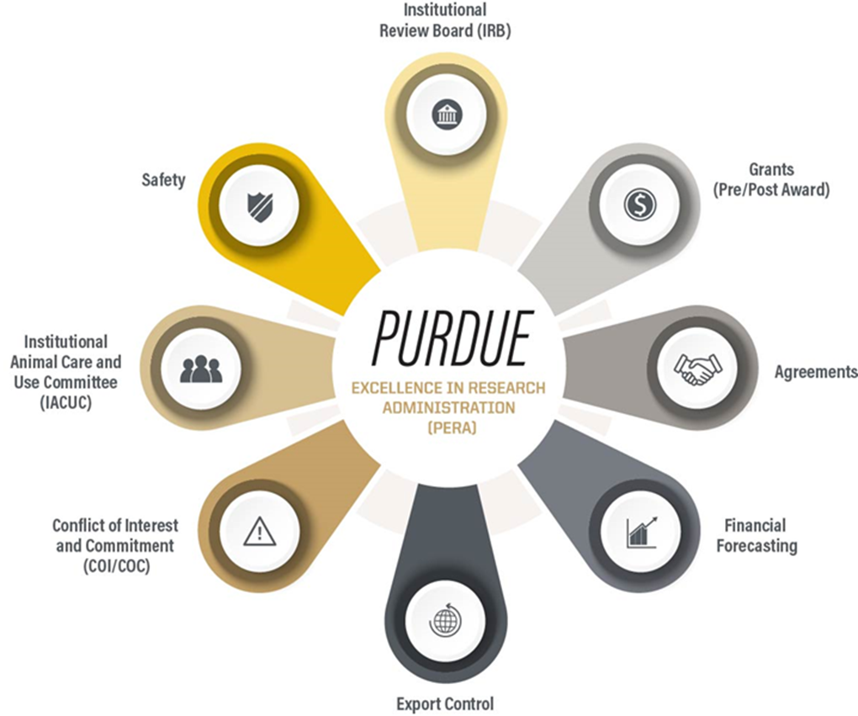
PERA: Purdue Excellence in Research Administration
In April, the Purdue Board of Trustees approved a $9.9 million investment in the Huron Research Suite – a SaaS product. This innovative electronic research administration system will serve all Purdue campuses and affiliated organizations.
Purdue’s brand for the Huron Research Suite, is PERA – Purdue Excellence in Research Administration. This project will implement a generation system that automates most processes involved with applying for research grants, managing research funding, and performing regulatory, ethics, training and compliance functions.

Slide 4
PERA: Purdue Excellence in Research Administration
Software as a Service (SaaS)
Generally regarded as an alternative to traditional on-premise software installations, SaaS is a software licensing and delivery model in which software is: hosted in the cloud, licensed on a subscription basis, and accessible via the internet.
ADVANTAGES
Cost – reduced hardware and software maintenance fees
Quick set-up/deployment – already installed and configured in the cloud
Delivered upgrades - upgrades deployed per schedule and less work for client
Accessibility – an internet and access to browser is all you need to connect
Scalability – offers flexibility to change subscription based on client need
DISADVANTAGES
Not customized for each user – delivered product may not meet 100% of client need and may require creative solutions to manage
Lack of control – vendor decides upgrade schedule and the user community receives the same changes in features
Connectivity requirement - if your internet service fails, you lose access to software

Slide 5
PERA: Purdue Excellence in Research Administration
Benefits of the Integrated System – Full Suite
Integration of Modules
Unified platform for monitoring most research activities
Ability to track workflow for specific activities
Personalized inbox to consolidate tasks
Enhanced transparency for the Purdue research community
System-wide reporting
Email notifications with direct link to the system
System to system proposal submission, with automated validation checks

Slide 6
PERA: Purdue Excellence in Research Administration
Overview – Where We Are
Later Stage of Testing Design / Integrations and Data Loads
Pre-Award
Post Award
Contracting
Early Stage of Testing Design and Data Loads
IACUC
Onboarding – System Capability Deep Dive
Safety – IBC
SOW Review
Export Control
To Come
COC/COI
IRB

Slide 7
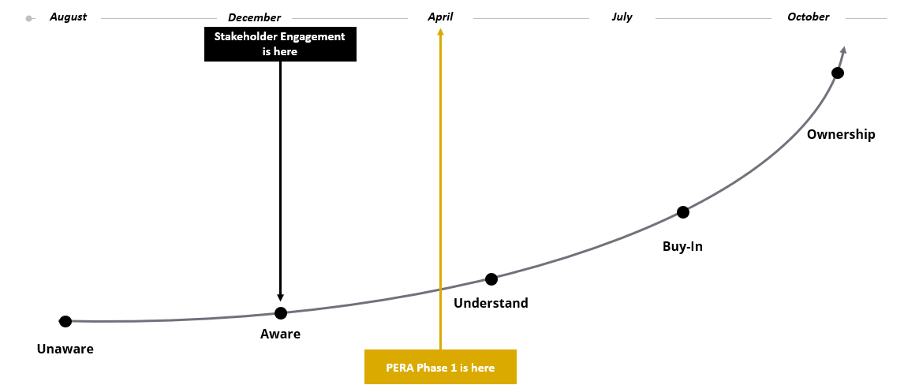
PERA: Purdue Excellence in Research Administration
Change Management Status

Slide 8
PERA: Purdue Excellence in Research Administration
What PERA Is
PERA will be used to…
Build proposal submission packages, including budget, and allows for system to system submissions
Manage non-financial award activities (award setup, prior approval requests, no cost extensions, etc.)
Track negotiation of sponsored contracts, including external activities
Access related proposals, awards, protocols, and contracts within the same system
Create, submit and update Institutional Animal Care and Use Committee (IACUC protocols
Complete and renew protocols for Institutional Biosafety Committee (IBC) registration
Apply and submit protocols, exemptions, and amendments to the Human Research Protection Program (coming in 2025)
Manage Technology Control Plans for export controlled projects

Slide 9
PERA: Purdue Excellence in Research Administration
What PERA Is Not
A Financial System
SAP will remain Purdue’s system of record for all Financial data
Faculty will still utilize GM AIMS for projections and portfolio inquiries
An Effort Reporting System
SEEMLESS will still be used for effort reporting at Purdue
A Procurement System
Existing procurement processes and systems will not change
A replacement for a faculty member’s local business office

Slide 10
PERA: Purdue Excellence in Research Administration
Overarching Impacts
Current State | Future State
Communication between parties is limited to emails (PI, finance, pre-award, post award, contracting, regulatory, and sponsors) | More activities and communication kept within PERA for tracking and maintaining long-term with some automated notifications
Proposals, Awards, and Agreements have limited relationship management | Transparent relationship management across modules to connect all applicable related activities
Multiple applications to track research activity (COEUS, PIP, PDD, ROA, Cayuse) | Singular system for research and regulatory-related activities
Status updates are manual and not regularly updated | Real-time status available within the system and which include system-generated notifications
Effort duplicated by PIs, pre-award, post award, contracting, regulatory, and finance teams | More automation and reduced duplication of effort in a single system
Manual and paper-based system for Export Control and Biosafety | Integrated modules dedicated to these functions and processes

Slide 11
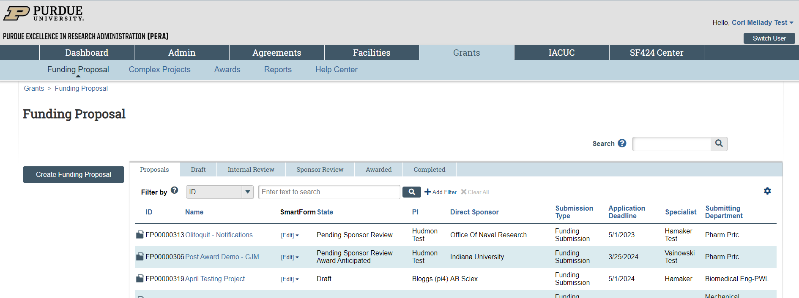
PERA: Purdue Excellence in Research Administration
Impacts to Researchers
Single login to access system to manage multiple functions
Increased transparency
Notifications providing direct link to system
Related activities across modules
In-system approvals for multiple activities

Slide 12
PERA: Purdue Excellence in Research Administration
Impacts to Research Administrators
Current State | Future State
Form 32s to track fiscal year cost-share commitments | Cost-share will be managed by project period instead of fiscal year
No institutional reporting capabilities for cost share commitments | Some institutional reporting capabilities for cost share commitments
Budget Allocations sent on excel file via email to post award | Direct entry of budget allocations into PERA
Manual workflow and approvals occurring after the fact | Fewer required approvals more reporting available for leadership
Budget creation using faculty effort to capture salary | Budget creation using input of person months to capture salary
Manual and paper-based systems and processes | Integrated modules to assist with more automated processes

Slide 13
Decision Making Considerations/Criteria
Faculty Impact: Are we contributing toward the Presidential mandate to save faculty one hour per day?
Customer Service: Are we delivering the highest level of customer service to enable researchers to concentrate on what they do best?
Data & Reporting: Are we capturing the data and reports that are needed?
Delivered Functionality: Rather than customizing, are we managing changes with business process changes where we can?
Compliance: Are we aligned with our internal controls and mandated Federal compliance?

Slide 14
PERA: Purdue Excellence in Research Administration
Decisions to date
Decisions Made
Systems decommissioned with PERA
Coeus
Proposal Information Portal
ROA
PDD
Cayuse (late calendar year 2025)
Several paper/spreadsheet-based processes
Credit Split
Academic Proposal/Award Credit Split will be handled pro-rata
Academic expenditure credit will be captured with RCC (no change)
DPD Center and Institute affiliation will be captured
Co-Investigators will receive proposal review/approval requests
DocuSign – enhanced version purchased
Engage with Deloitte Consulting to address OCM strategy
Decisions Made (Continued)
Safety Module – exclusion of Chemical and Radiation Safety
PI/Co-Investigator – academic leadership hierarchy to receive proposal review/approval request or manage via reports
Academic leadership approval for Post-Award Prior Approval requests (Change in PI, Budget Changes and No Cost Extensions)
Decisions Pending
ORCiD – investigating how to most effectively pull into PERA
Specific go-live dates for Grants & Agreements and IACUC Modules
Will be fall 2024 – likely early October

Slide 15
Project Timeline*
We are here
*Updated April 2024, and subject to change

