Slide 1


Purdue excellence in research administration: PERA – IRB Module Demo
October 2025
Sarah Abney, HRPP Director

Slide 2
PERA: Purdue Excellence in Research Administration
Information Session Logistics
Please remain muted throughout the session
Log your questions in the chat feature – will be monitored and answered as they appear. Time will be left at the end of the demo for additional questions.
This is one of two sessions (October 14 & 22)
Each session will be recorded
Content for each session is the same
Recording and consolidated Q&A will be posted to PERA website

Slide 3
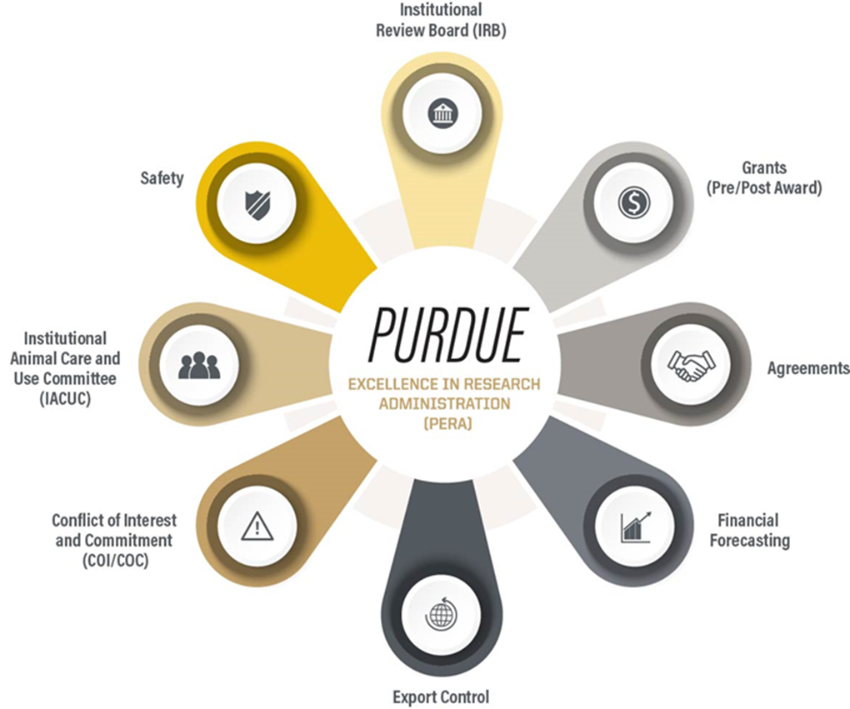
PERA: Purdue Excellence in Research Administration
What Is PERA?
In April 2023, Board of Trustees approved initial investment for innovative eRA system that will serve all Purdue campuses and affiliated organizations.
PERA – Purdue Excellence in Research Administration system is a new electronic research administration system which rolled out in October 2024, impacting all faculty researchers and instructors.
Grants, Agreements, IACUC, IBC-Safety, RSEC, and COI/COC currently use PERA and IRB will be the final full module to join!
Notes:
PERA is a system that handles multiple research administration units including grants, IACUC, COC, etc…The first PERA modules rolled out or went live last October and now the IRB module will be implemented.

Slide 4
Cayuse Protocols Migrated to the PERA System
Important items to remember:
Cayuse protocols in ACTIVE status as of 10/10/2025 will be migrated to PERA.
  This excludes JIT, NHSR, and COEUS protocols.
You do NOT have to immediately log into PERA to convert your protocols when PERA goes live on October 27th.
You DO need to complete the protocol template and any unanswered PERA questions when you submit your first follow-on submission (modification or continuing review).
Notes:
This is not something that is covered in the Demo today but there will be instructions and materials on how to convert your Cayuse active studies. You will need to put your application into the new Word document protocol templates.

Slide 5
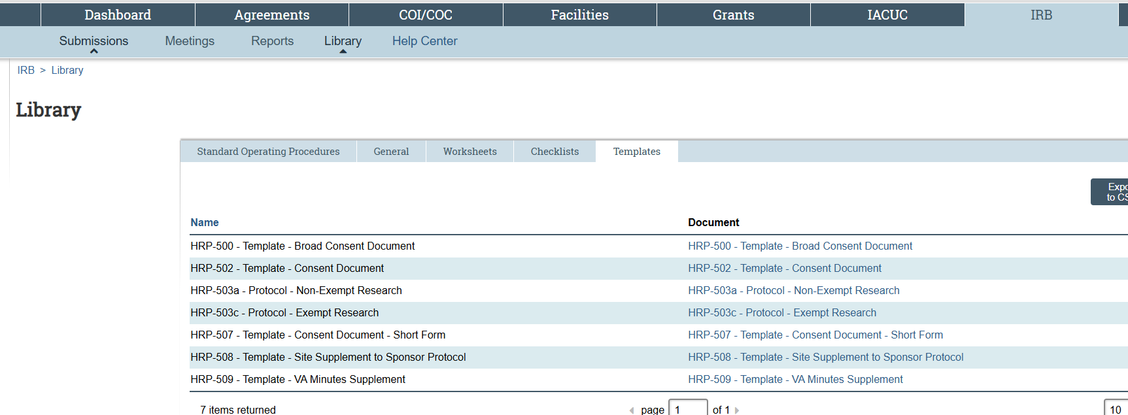
PERA: Purdue Excellence in Research Administration
Templates
PERA will use a basic Smartform and most of the detailed information will be provided in specific Protocol Templates and applicable appendices
Templates and appendices are housed on the PERA site in the Library
Notes:
Unlike Cayuse which is entirely SmartForm based, the SmartForm in PERA will capture basic study information which will help with reporting and study assignments within the IRB office. You will put the majority of the study details into the Word document protocol template and applicable appendices. Currently these are housed on the PERA IRB GO LIVE PAGE but after go live, they will be found in the PERA Library.

Slide 6
PERA: Purdue Excellence in Research Administration
Demonstration– IRB Module
  Dashboard
    My Inbox - any submission that requires your action in the workflow
    My Reviews (more for admin and committee)
    Recently Viewed – Can navigate to most recent or use it to PIN a protocol for quick reference
  IRB Tab
    Submissions
      Create Protocol, Create Reportable New Information
      See different categories – In-Review, Active, New Information Reports, External IRB, Relying Sites
    Library and Help Center
Notes:
Some notes for the Demo include...

Slide 7
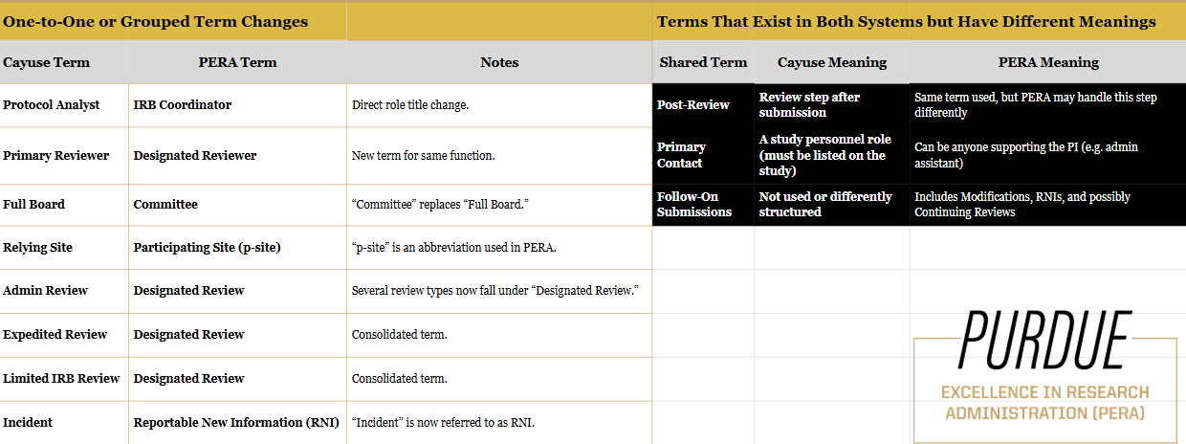
Cayuse to PERA Crosswalk
Notes:
Primary Contact not required in PERA, defaults to the PI however if this is a study personnel then they need to be added to the study
this information will be on the PERA Training website

Slide 8
PERA: Purdue Excellence in Research Administration
Help After Go-Live
PERA Training Website
  https://pera.research.purdue.edu/training/
  PERA Help
    IRB Specific Question
      You may make an appointment with IRB Staff Members using Microsoft Bookings. Link to the Microsoft Bookings Page will be on PERA Help - Purdue Excellence in Research Administration
    PERA Website Questions
  Submit a PERA Help Ticket

