Slide 1


Purdue excellence in research administration: PERA – IACUC Module Demo
September 2024
Lisa Snider, IACUC Administrator

Slide 2
PERA: Purdue Excellence in Research Administration
Information Session Logistics
Please remain muted throughout the session
Log your questions in the chat feature – will be monitored and answered as they appear. Time will be left at the end of the demo for additional questions.
This is one of two sessions (September 17 & 19)
Each session will be recorded
Content for each session is the same
Recording and consolidated Q&A will be posted to PERA website

Slide 3
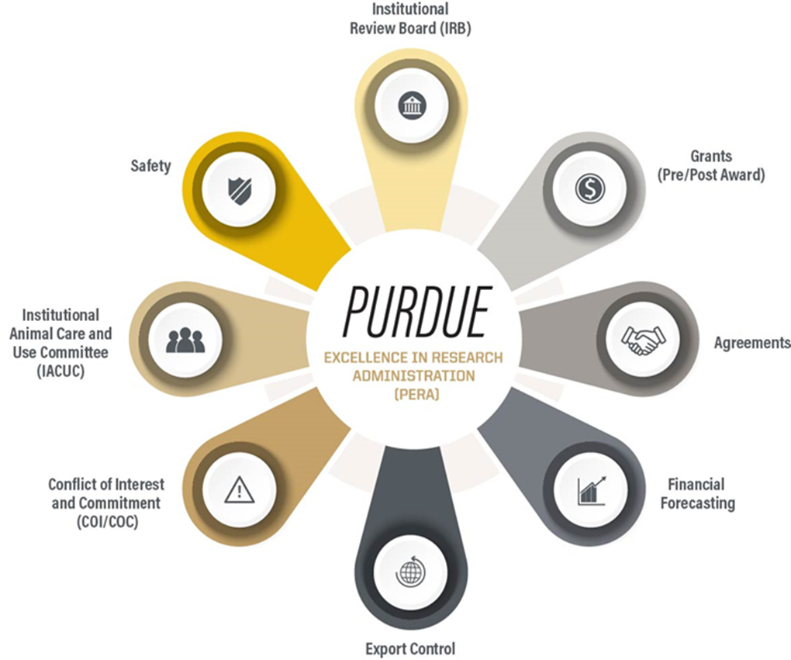
PERA: Purdue Excellence in Research Administration
What Is PERA and Why Now?
In April 2023, Board of Trustees approved initial investment for innovative eRA system that will serve all Purdue campuses and affiliated organizations.
PERA – Purdue Excellence in Research Administration system is a new electronic research administration system which will roll out this fall, impacting all faculty researchers and instructors.
The initial modules – Grants, Agreements, and IACUC will go-live on Monday, October 7. Additional modules will roll out in 2025.

Slide 4
PERA: Purdue Excellence in Research Administration
Migrating from Coeus IACUC to PERA IACUC
What will be pre-populated for PI’s in PERA:
Title of the protocol
PI Name & Study Personnel
Alternatives Search Information
Training information for personnel
A few other miscellaneous items (e.g., approval dates, expiration dates, etc.)
Attachments from Coeus will be brought over and saved in the Supporting Documents tab.
What will NOT be pre-populated for PI’s in PERA:
Any protocol information in the Word document
Important to note that any tables, graphs, flowcharts, etc., will not copy and paste into the PERA protocol. These will have to be saved as a separate attachment and uploaded to the Supporting Documents.
You will not be required to move your protocol information from the Word document immediately; however, the first time you do a follow-on submission, it will need to be copied and pasted over to the smart forms.

Slide 5
Coeus Protocols Migrated to the PERA System
Important items to remember:
Coeus IACUC Protocols will be migrated into the PERA system the week of September 30-October 4.
You do NOT have to immediately go into PERA to convert your protocols to the Smart Forms when PERA goes live on October 7.
You will need to do conversions when you submit your first follow-on submission (i.e., amendment, annual continuation, triennial renewal).

Slide 6
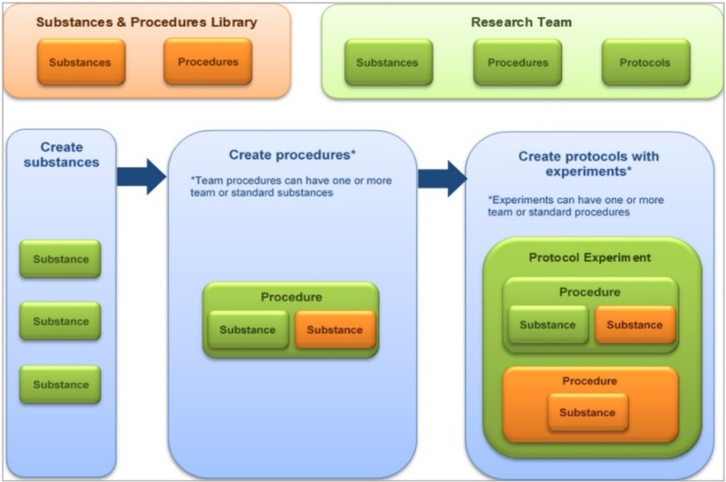
PERA: Purdue Excellence in Research Administration
PERA Building Blocks - (Foundations of a Protocol)
Create a Research (Animal Use) Team
Create Team Substances
Create Team Procedures

Slide 7
EXAMPLES of Building Blocks
Research (Animal Use) Team
Team Substances
Team Procedures
Research (Animal Use) Team: Darbyshire Team
Team Substances: Isoflurane, lidocaine, K/X, midazolam, telazol, atipamezole, meloxicam, ethiqaXR, buprenorphine HCl
Team Procedures: Survival surgery, euthanasia, substance administration, imaging, other non-surgical procedures, blood collection, injections

Slide 8
EXAMPLES of Building Blocks
Research (Animal Use) Team
Team Substances
Team Procedures
Research (Animal Use) Team: Schoenlein Team
Team Substances: Isoflurane, propofol, T/K/X, acepromazine, butorphanol, buprenorphine ER, carprofen, meloxicam
Team Procedures: Survival surgery, euthanasia, substance administration, imaging, other non-surgical procedures, blood collection, injections

Slide 9
PERA: Purdue Excellence in Research Administration
Demonstration– IACUC Module
General Navigation
  Dashboard
    My Inbox - any submission that requires your action in the workflow
    My Reviews (more for admin and committee)
    Recently Viewed – Can navigate to most recent or use it to PIN a protocol for quick reference
  IACUC Tab
    Submissions
      Create Concern, Research Team, Protocol
      See different categories – Your Research Teams, In-Review, Active, Archives, or All Submissions
    Standard Library – Standard Procedures & Substances to be used in protocols

Slide 10
PERA: Purdue Excellence in Research Administration
Help After Go-Live
Microsoft Bookings
  You may make an appointment with IACUC Staff Members using Microsoft Bookings.
    These will be in-person or virtual appointments. We are offering 30 minute time slots.
  Link to the Microsoft Bookings Page:
https://outlook.office365.com/owa/calendar/Bookings-PERAIACUCModuleHelp@purdue.edu/bookings/
PERA Website
  https://pera.research.purdue.edu/training/
  IACUC Email
  iacuc@purdue.edu

Slide 11

PERA: Purdue Excellence in Research Administration
Questions – Please put into the chat feature and we will do our best to answer them.

